Slide 1

Engagement Survey Results
2023-2024
Prakash, Rod, Travis
1/16/2025

Slide 2
Elevator Pitch
“Would you like to know if your employees are happy and engaged at work? We can answer that question with data, using a survey analysis and our data analytics process. By providing us with your survey data that was just sitting in a drawer, we can analyze it and return a product that shows you with visuals exactly how engaged is your workforce and how that relates to key employee datapoints.”

Slide 3

What is employee engagement, and why does it matter?
Employe Engagement: the level of enthusiasm, dedication, and commitment an employee feels towards their work and organization
Why it matters: Measuring employee engagement matters because it provides critical insights into workforce motivation, satisfaction, and overall productivity.
Problem Statement: How does engagement relate to HR variables? Can we know who is more engaged and productive? What is the relationship between engagement and work-life satisfaction and job satisfaction?

Slide 4

How is engagement measured?
Employee engagement is measured periodically throughout the year in engagement surveys that generally include these three questions:
“I feel motivated and engaged in my work.”
“I am satisfied with my job.”
“I am able to maintain a healthy balance between my work and personal life.”
Objective: Answer the research questions using the database of employee information provided by the client in conjunction with the results of a recent employee engagement survey.

Slide 5
Research Questions
1. Do top performers have a worse work-life balance?
2. Do software engineers have higher job satisfaction than everyone else?
5. Is there a correlation between job satisfaction and employee engagement?
6. Is there a correlation between job satisfaction and work-life balance?
3. Is there an equivalent employee performance rating across genders?
4. What are the current relationships between employee type and performance scores?

Slide 6

Methods
To see if there was a significant difference between two groups, we used error bar plots (Ex: Q1. Comparing the work-life balance scores Software Engineers to everyone else)
To see if there was a significant difference between many groups, we used bar graphs with error bars (Ex: Q2.. Job satisfaction across groups)
The data required no clean-up
Data was organized using Pandas, specifically dataframes and plots were created using the pyplot module of matplotlib

Slide 7
Our Data
Source = Fictional Company’s HR dept.
Sample size = 3,000
Key Features = Employee Database + Engagement Survey Results

Slide 8
Questions 1-2
Do top performers have a worse work-life balance?
Do software engineers have better job satisfaction than everyone else?
Short answer: No (in our sample)
What does the research say?
Work engagement, which is closely tied to work-life balance, has been found to positively affect job performance, organizational commitment, and financial returns (Albdour & Altarawneh, 2014; Bakker et al., 2012; Salanova et al., 2005).
Short answer: No (in our sample)
What does the research say?
Make Me a Programmer reports that software engineers often experience high job satisfaction due to factors like autonomy, pay, flexibility, and engaging work. These elements contribute to software engineering being rated as one of the top jobs in various employment surveys.

Slide 9
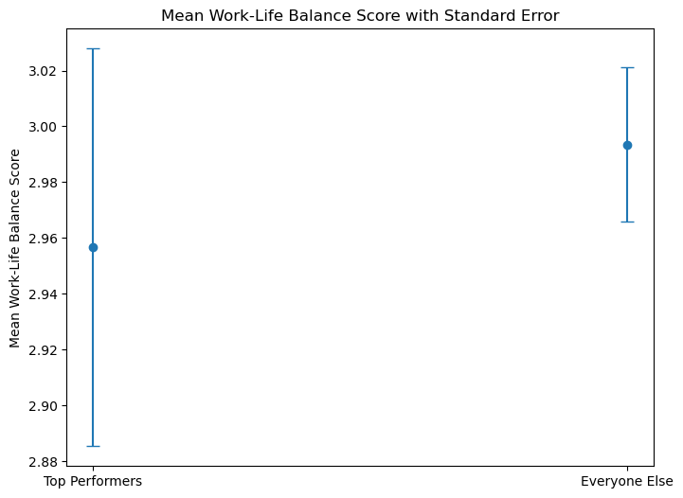
Question 1 – Figure 1
Our sample did not show a significant difference in work-life balance between top-performers and everyone else
For top performers, SEM was larger due to being a smaller subset of the sample than the Everyone Else Group

Slide 10
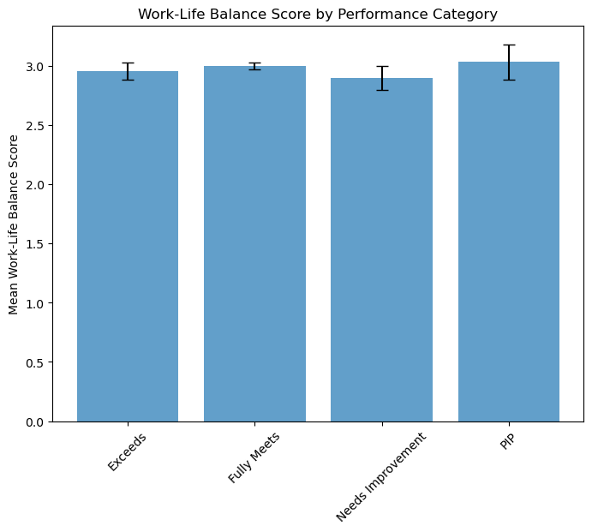
Question 1 – Figure 2
Next, we looked at the Work-Life Balance scores for all Performance Categories.
There was no significant difference between the groups, as demonstrated by the overlap of the SEM.

Slide 11
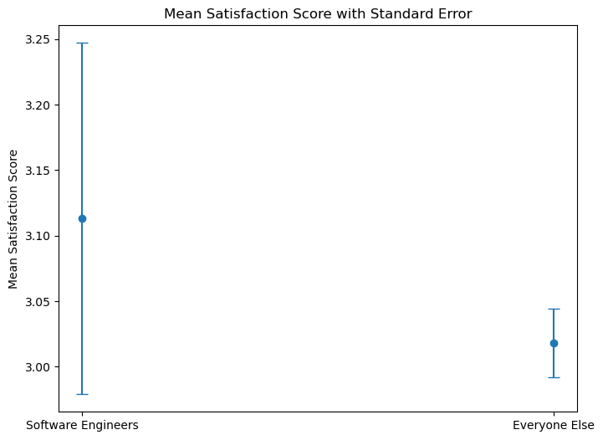
Question 2 – Figure 1
For question 2, we analyzed whether the software engineers in our sample were more satisfied with their role.
No significant difference means that they are likely as equally satisfied as everyone else.

Slide 12
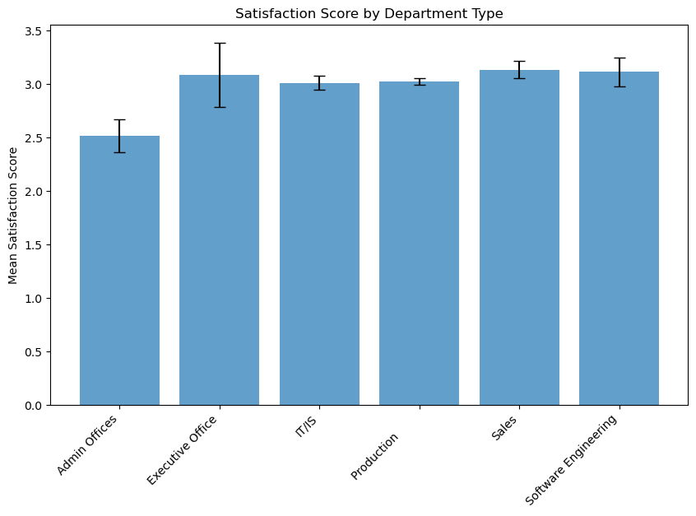
Question 2 – Figure 2
Next, we looked at the Job satisfaction scores between all the departments.
There appears to be a significant difference between the Admin Offices and everyone else. They are less satisfied.

Slide 13
Questions 3-4
Is there an equivalent employee performance rating across genders?
What are the current relationships between employee type and performance scores?
Does being a full-time, part-time, or contracted employee contribute to job performance. Full-time employees often experience burnout, part-time employees can be paid less, and contracted employees often hold more autonomy in their positions, resulting in higher job satisfaction, participation, and pay
Historical data and research indicates that gender bias in performance evaluations has been a significant issue, efforts are underway across many industries to address and reduce these biases.

Slide 14
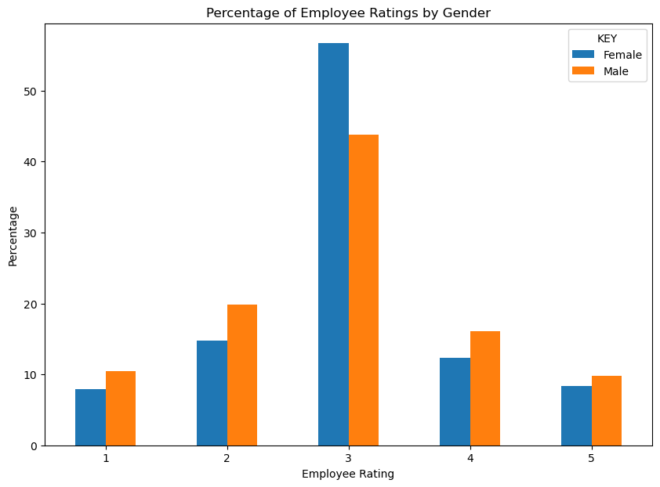
Question 3 – Figure 1
The chart to the right presents the percentage of male and female employees divided among each employee rating, 1-5.
There was no bias found between female and male employee ratings. For each rating, 1-5, female and male rating percentages never differed by more than 15%. This presents that there was minimal to no gender discrimination when measuring employee performance.

Slide 15
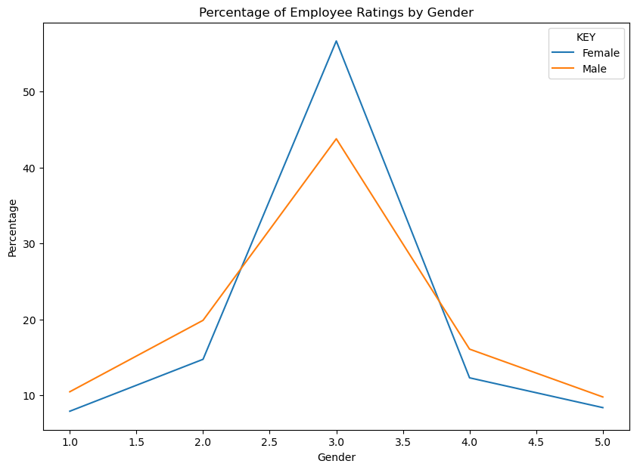
Question 3 – Figure 2
This chart displays the same data form the previous, but illustrated as a line chart, which presents an alternative perspective that simplifies the results.
To the right you can see there is an increase in female percentage from ratings from 2.5 - 4.0

Slide 16
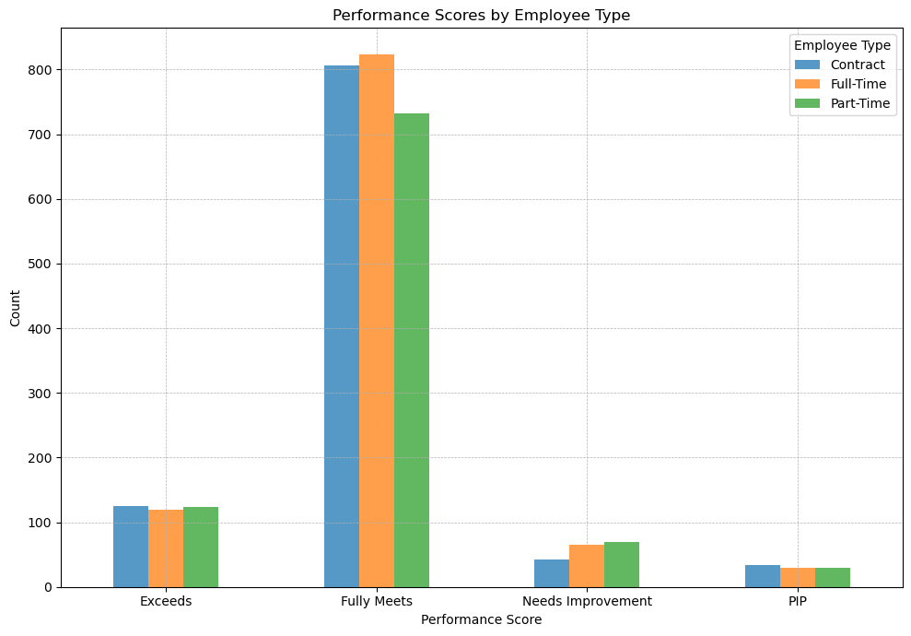
Question 4 – Figure 1
The chart on the right displays our findings in How employees performed based on their Employee Type.
In the "Fully Meets" category, you can see there is a drop in part time employees, but the difference is not large enough to say part time employees are underperforming, for this small margin, there are a few variables that could cause this. Although, part time employees are also highest rated "Needs Improvement"

Slide 17
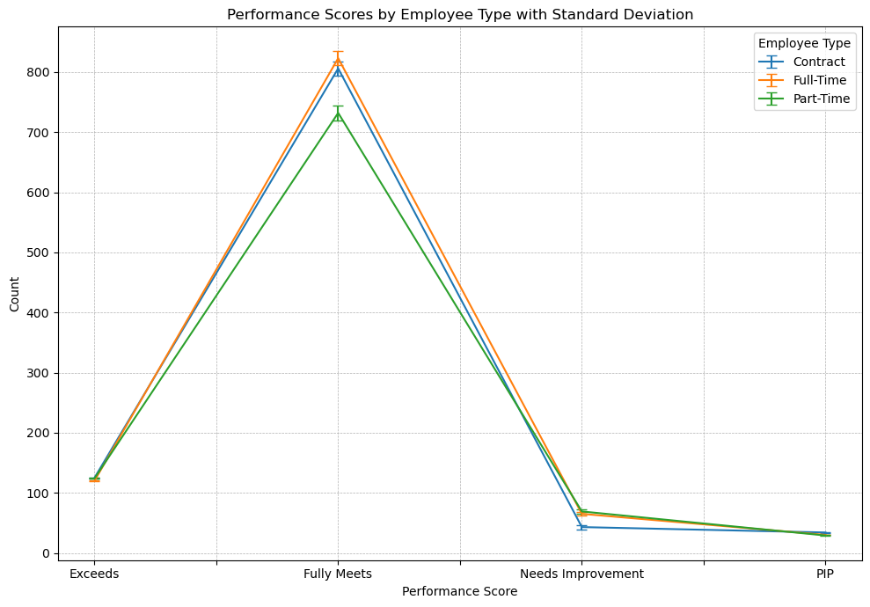
Question 4 – Figure 2
This chart displays the same data form the previous, but illustrated as a line chart, which presents an alternative perspective that simplifies the results.
All employee types meet similar benchmarks in each category, while Part-Time employees are under performing when it comes to the fully meeting expectations, this could be due to a number of variables, most likely being that part-time workers have less hour to contribute.

Slide 18
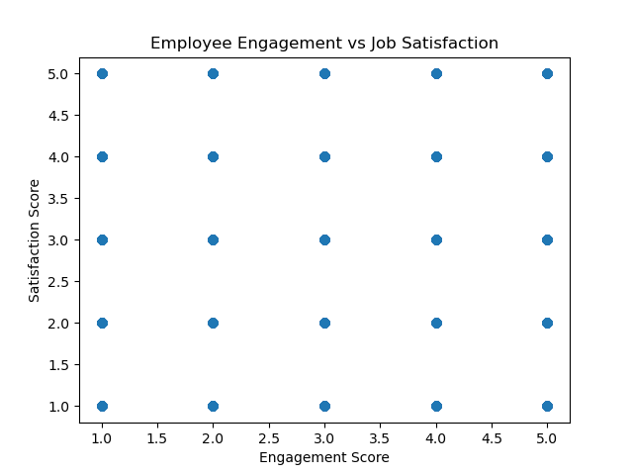
Question 5
Is there a correlation between job satisfaction and employee engagement?
Answer within this dataset:
No. With a correlation score of –0.0075 the correlation is close to zero. The correlation score shows there is no statistical correlation between job satisfaction and employee engagement.
According to Workforce for Science, while the two can be linked, they are quite different ideas. There are numerous factors that can be linked to either idea and correlating outcomes.
Extraneous factors could change the outcomes.

Slide 19
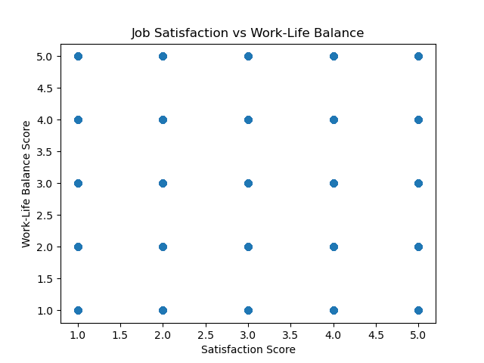
Question 6
Is there a correlation between job satisfaction and work life balance?
Answer within this dataset:
No. With a correlation score of 0.0247 the correlation is close to zero. With the score being close to zero, there is statistically no correlation between job satisfaction and work life balance.
According to The Journal of Business and Management, Job Satisfaction and Work Life Balance correlation can vary on various factors such as workplace environment, employee demographics and organizational policies. '
While the two could be linked given the scope of our dataset the results are conclusive.

Slide 20
References
Albdour, A. A., & Altarawneh, I. I. (2014). Employee engagement and organizational commitment: Evidence from Jordan. International Journal of Business, 19(2), 192–212.
Make Me a Programmer. (2019, April 3). Are software engineers happy? Yes, they are, and here's why. https://makemeaprogrammer.com/are-software-engineers-happy/
Workforce For Science . (2025, January).Employee Engagement Vs. Job Satisfaction https://workforcescience.com/learn/articles/employee-engagement-vs-job-satisfaction IOSR Journal of Business and Management.(2018, May)
Abdirahman, H. I. H., Najeemdeen, I. S., Abidemi, B. T., & Ahmad, R. B. (2018). The relationship between job satisfaction, work-life balance, and organizational commitment on employee performance. IOSR Journal of Business and Management, 20(5), 76–81. https://www.iosrjournals.org/iosr-jbm/papers/Vol20-issue5/Version-7/I2005077681.pdf

Slide 21
Challenges and Future Work
Challenges
Data was too uniform, significant differences were very hard to find
It would be incredibly unlikely to see that level of evenness in real-world data
Future Work
Dataset include 2 other databases we could use: training data and recruitment data
Would be ideal to go back to client and ask for their area of focus to optimize the analysis and presentation

